Slide 1




Generating Assurances Through ALPACA: Autonomous Learning with Probability and Abstraction for Competency Awareness
Nisar Ahmed
Associate Professor
Ann and H.J. Smead Aerospace Engineering Sciences
University of Colorado at Boulder
Raytheon AI Assurance Workshop
August 10, 2023

Slide 2
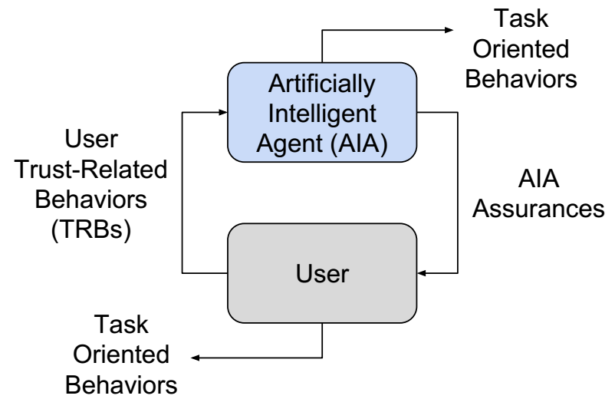
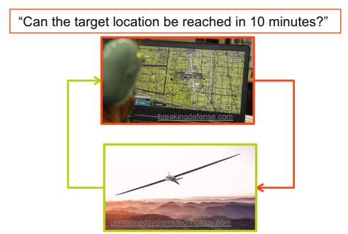
Competency-Aware Autonomous Systems
Trust important for “best” usage/deployment of autonomous systems
Algorithmic assurances = signals to modulate/calibrate user trust
[Israelsen and Ahmed, “Dave…I can assure you…that it’s going to be alright…,” ACM Surveys, 2019]

Slide 3
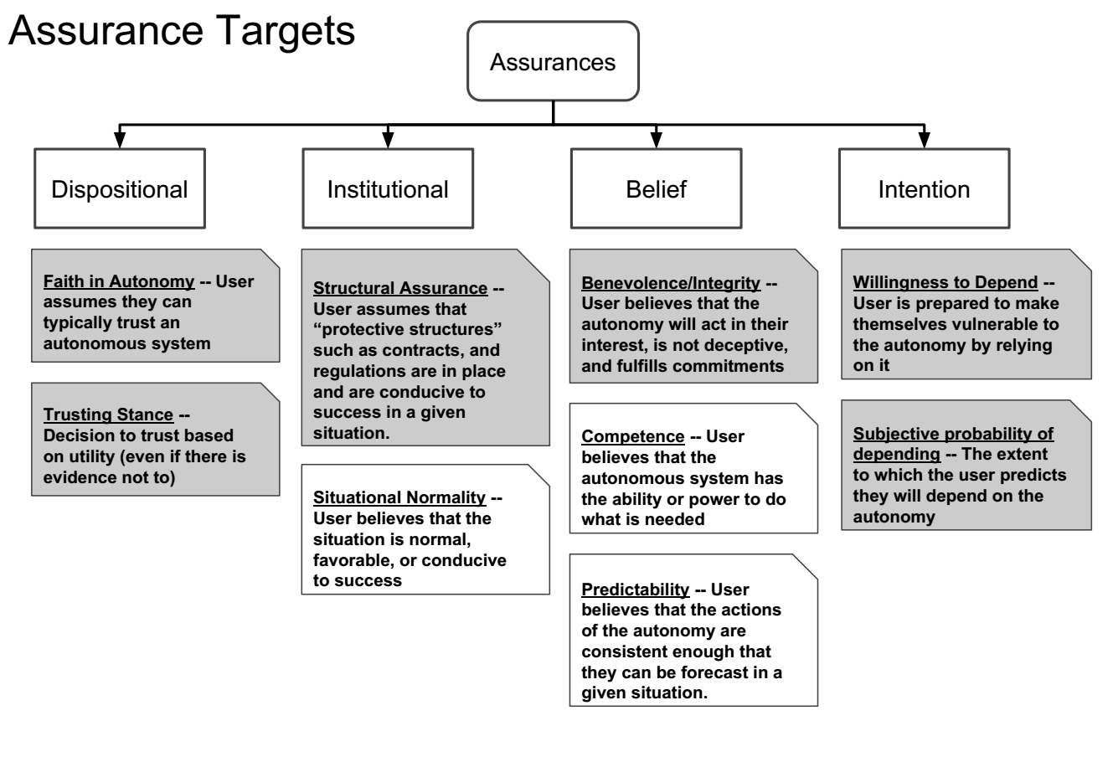
Competency-Aware Autonomous Systems
How to design assurances for non-deterministic algorithms?
statistical machine learning
probabilistic planning/perception
stochastic control, state estimation
[Israelsen and Ahmed, “Dave…I can assure you…that it’s going to be alright…,” ACM Surveys, 2019]

Slide 4
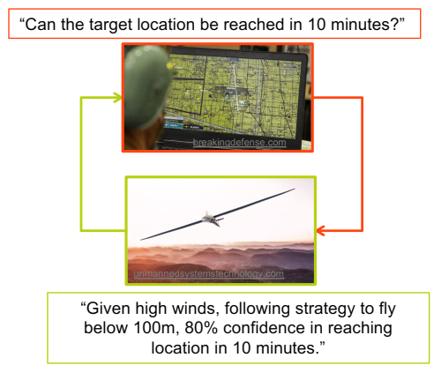
Machine Self-Confidence [Hutchins, Cummings, Hughs, HFES 2015]
Self-confidence = perceived ability to execute assigned tasks,
despite uncertainties in…
knowledge of world
own/self state
reasoning process and execution abilities
Requires algorithmic introspection
Cognitive neuroscience connections
humans “meta-reason” about “uncertainty in uncertainty” to gauge own visual/motor skills [Bang, Moran, Daw, Fleming, Nature 2022]

Slide 5
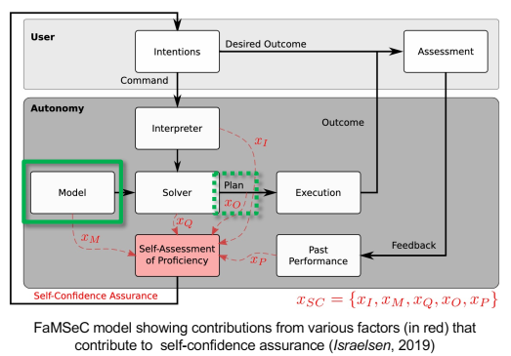
Factorized Machine Self-Confidence (FaMSeC) Framework
Systematic way to compute and report self-confidence to non-expert users
Analyze the “statistical juices” flowing from probabilistic algorithms
At least 5 factors to consider in autonomous decision-making:
Are outcomes as expected?
Is plan as good as needed?
Are models consistent with reality?
Is task correctly understood?
How did things go in past?
How to formally measure and correctly communicate?

Slide 6



DARPA Competency Aware Machine Learning (CAML)
Generalize FaMSeC to model-based reinforcement learning using deep learning neural nets as probabilistic world models to assess task competencies:
Model-based RL Framework
Capturing relevant experience
Inferring emergent strategies
Quantifying self-confidence
Summarizing the above in human-understandable form

Slide 7
DARPA Competency Aware Machine Learning (CAML)
Metrics for success:
Coverage: do experiences capture all conditions that contribute to failure/success?
Correctness: are learned agent responses described by identified strategies?
Fidelity: do agent competency reports accurately forecast/describe outcomes?
Reliability: are reported competency levels maintained?
Model-based RL Framework

Slide 8
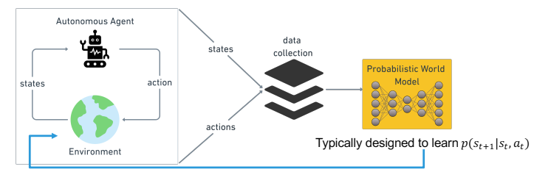
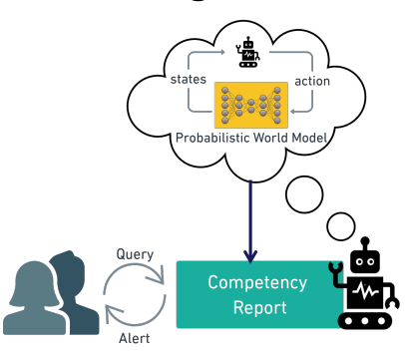
DARPA Competency Aware Machine Learning (CAML)
Generalize FaMSeC to model-based reinforcement learning using deep learning neural nets as probabilistic world models to assess task competencies
Deep Neural Net
Major technical research challenges:
-offline / online assessments for arbitrary tasks & competency standards?
-how to design deep NN models to predict relevant uncertainties over large time horizons?
-how to implement/evaluate reports with actual human users?

Slide 9

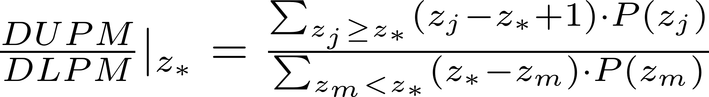
Generalized Statistical Task Outcome Assessments [Conlon, et al SciTech 2022; ACM Surveys 2023]
Simulate closed-loop actions to get “statistical success margin” (upper/lower partial moment) on arbitrary task outcomes X (converted to rank ordered outcomes Z with user standard z*)
Offline / a priori: lots of simulations
Online / in situ: Event-triggered computation based on probabilistic surprise index (~p-value)
Translate upper/lower partial moment into understandable semantics
Desired rank: user wants X at/above this
Outcome statistics (unranked equiv. classes)
Ranked outcome stats
Learned PWM
…
…
Simulation traces
x₂
…
x₁
x_{N-1}
x_{N}
z₁=1
z₂=2
z_{N}=N-1
z_{N}=N
(0)
…
(>10)
(0)
State-Action-Reward Prediction Rollouts
Example: # obstacles hit:
(1-2)
(8-10)
(>10)
(8-10)
(1-2)
s(t)/a(t)/r(t)
Model-based Planner
-1
-0.5
Very
good
+0.5
+1
-0.1
+0.1
0
t
Good
Competency statement:
“Confidence in meeting
expected outcomes for X is good”
Fair
Bad
Very
bad
Notes:
Jamison’s (now at LM) work

Slide 10
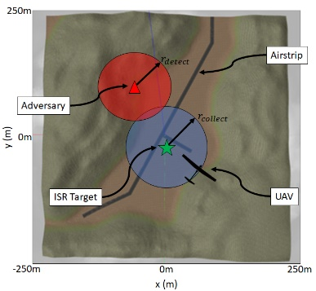
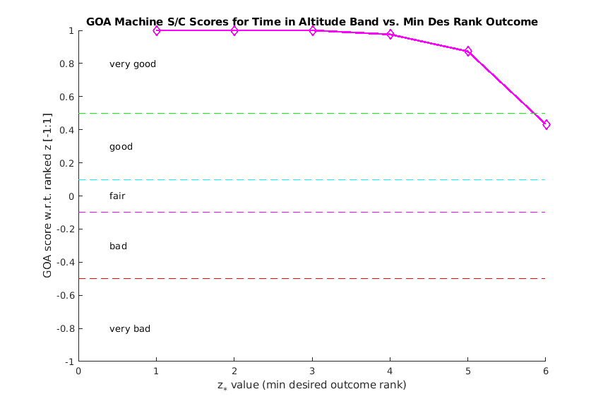
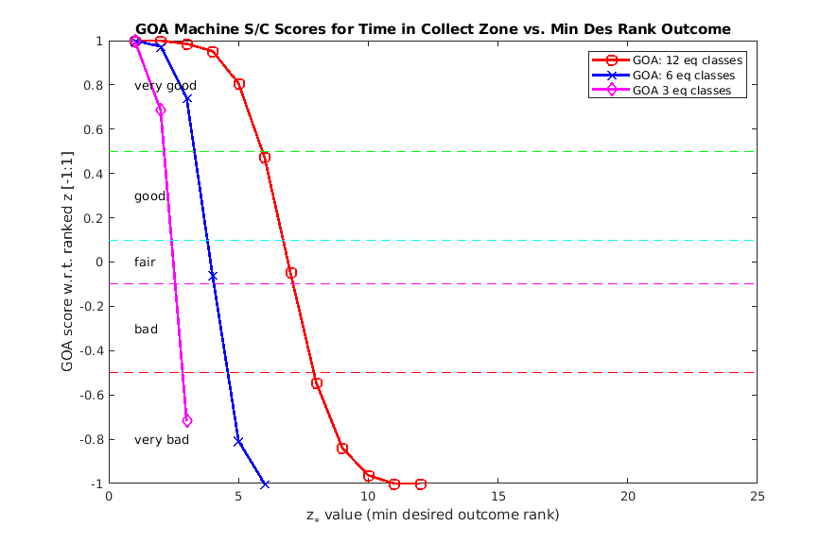
Example Application: Simulated Small UAS Radio Surveillance [Conlon, et al SciTech 2022]
Task: snoop on adversary radio comms tower:
must avoid detection by ground sentry, while flying in non-uniform wind field
must maintain altitude within given window
must maximize time in data collection zone, with limited battery power
Supervisor decides on “go/no-go” for task using a priori competency reports…
UAS very confident in holding altitude in varying wind…
UAS much less confident in staying near tower in high wind…
Notes:
Jamison’s (now at LM) work

Slide 11
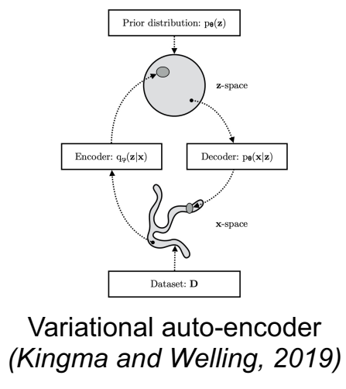
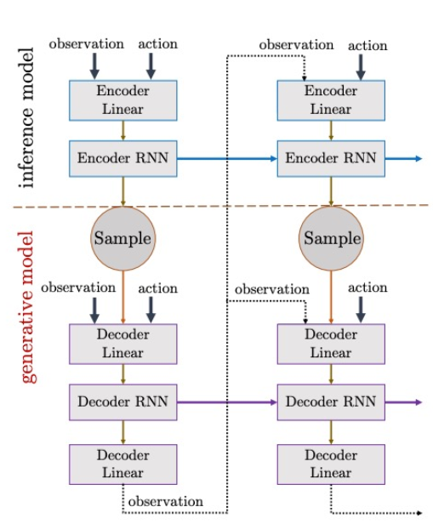
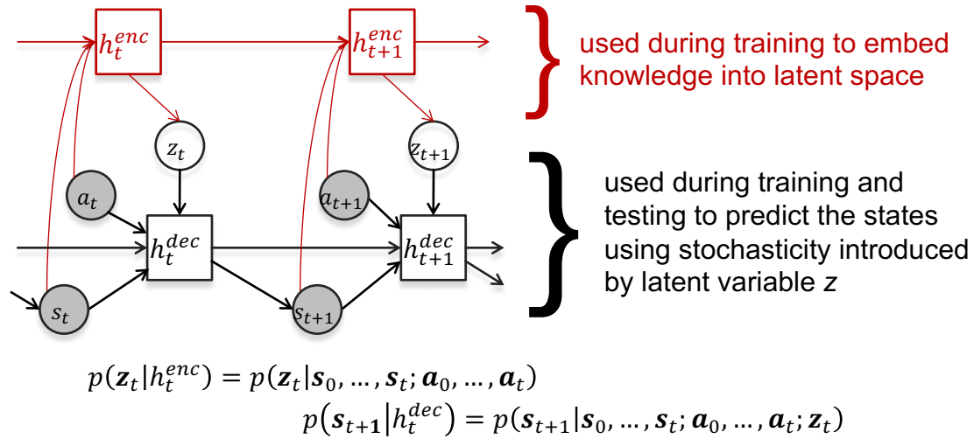
Deep Probabilistic World Modeling for Competency Assessment [Acharya, Russell, Ahmed, IROS 2022]
Outcome predictions over long time horizons can be very challenging:
Deep neural nets for model-based RL: look one step ahead for stochastic MPC
➔ Good for single task, but we must account for multiple tasks in same environment
Non-linear, non-stationary, non-Markov interactions: hard to infer from limited training data
➔ RNN-VAE neural net architecture to capture these characteristics
Notes:
Aastha’s work

Slide 12
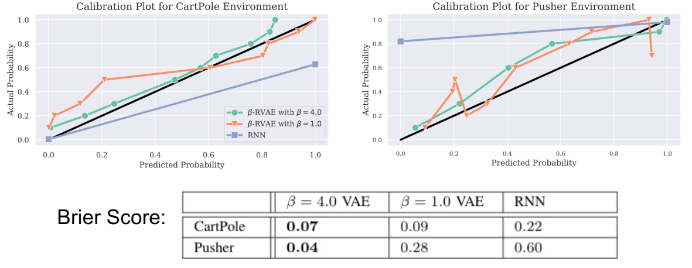
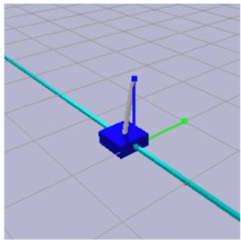
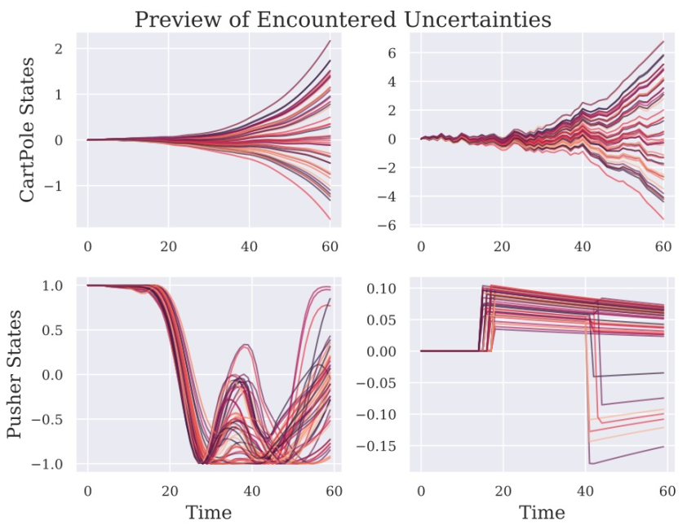
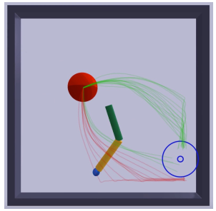
Deep Probabilistic World Modeling for Competency Assessment [Acharya, Russell, Ahmed, IROS 2022]
OpenAI Gym benchmark results vs. simple recurrent neural net (RNN):
Stochastic “CartPole” (inverted pendulum)
Stochastic “Pusher Robot” (push ball with 2 link arm)
Notes:
Aastha’s work

Slide 13
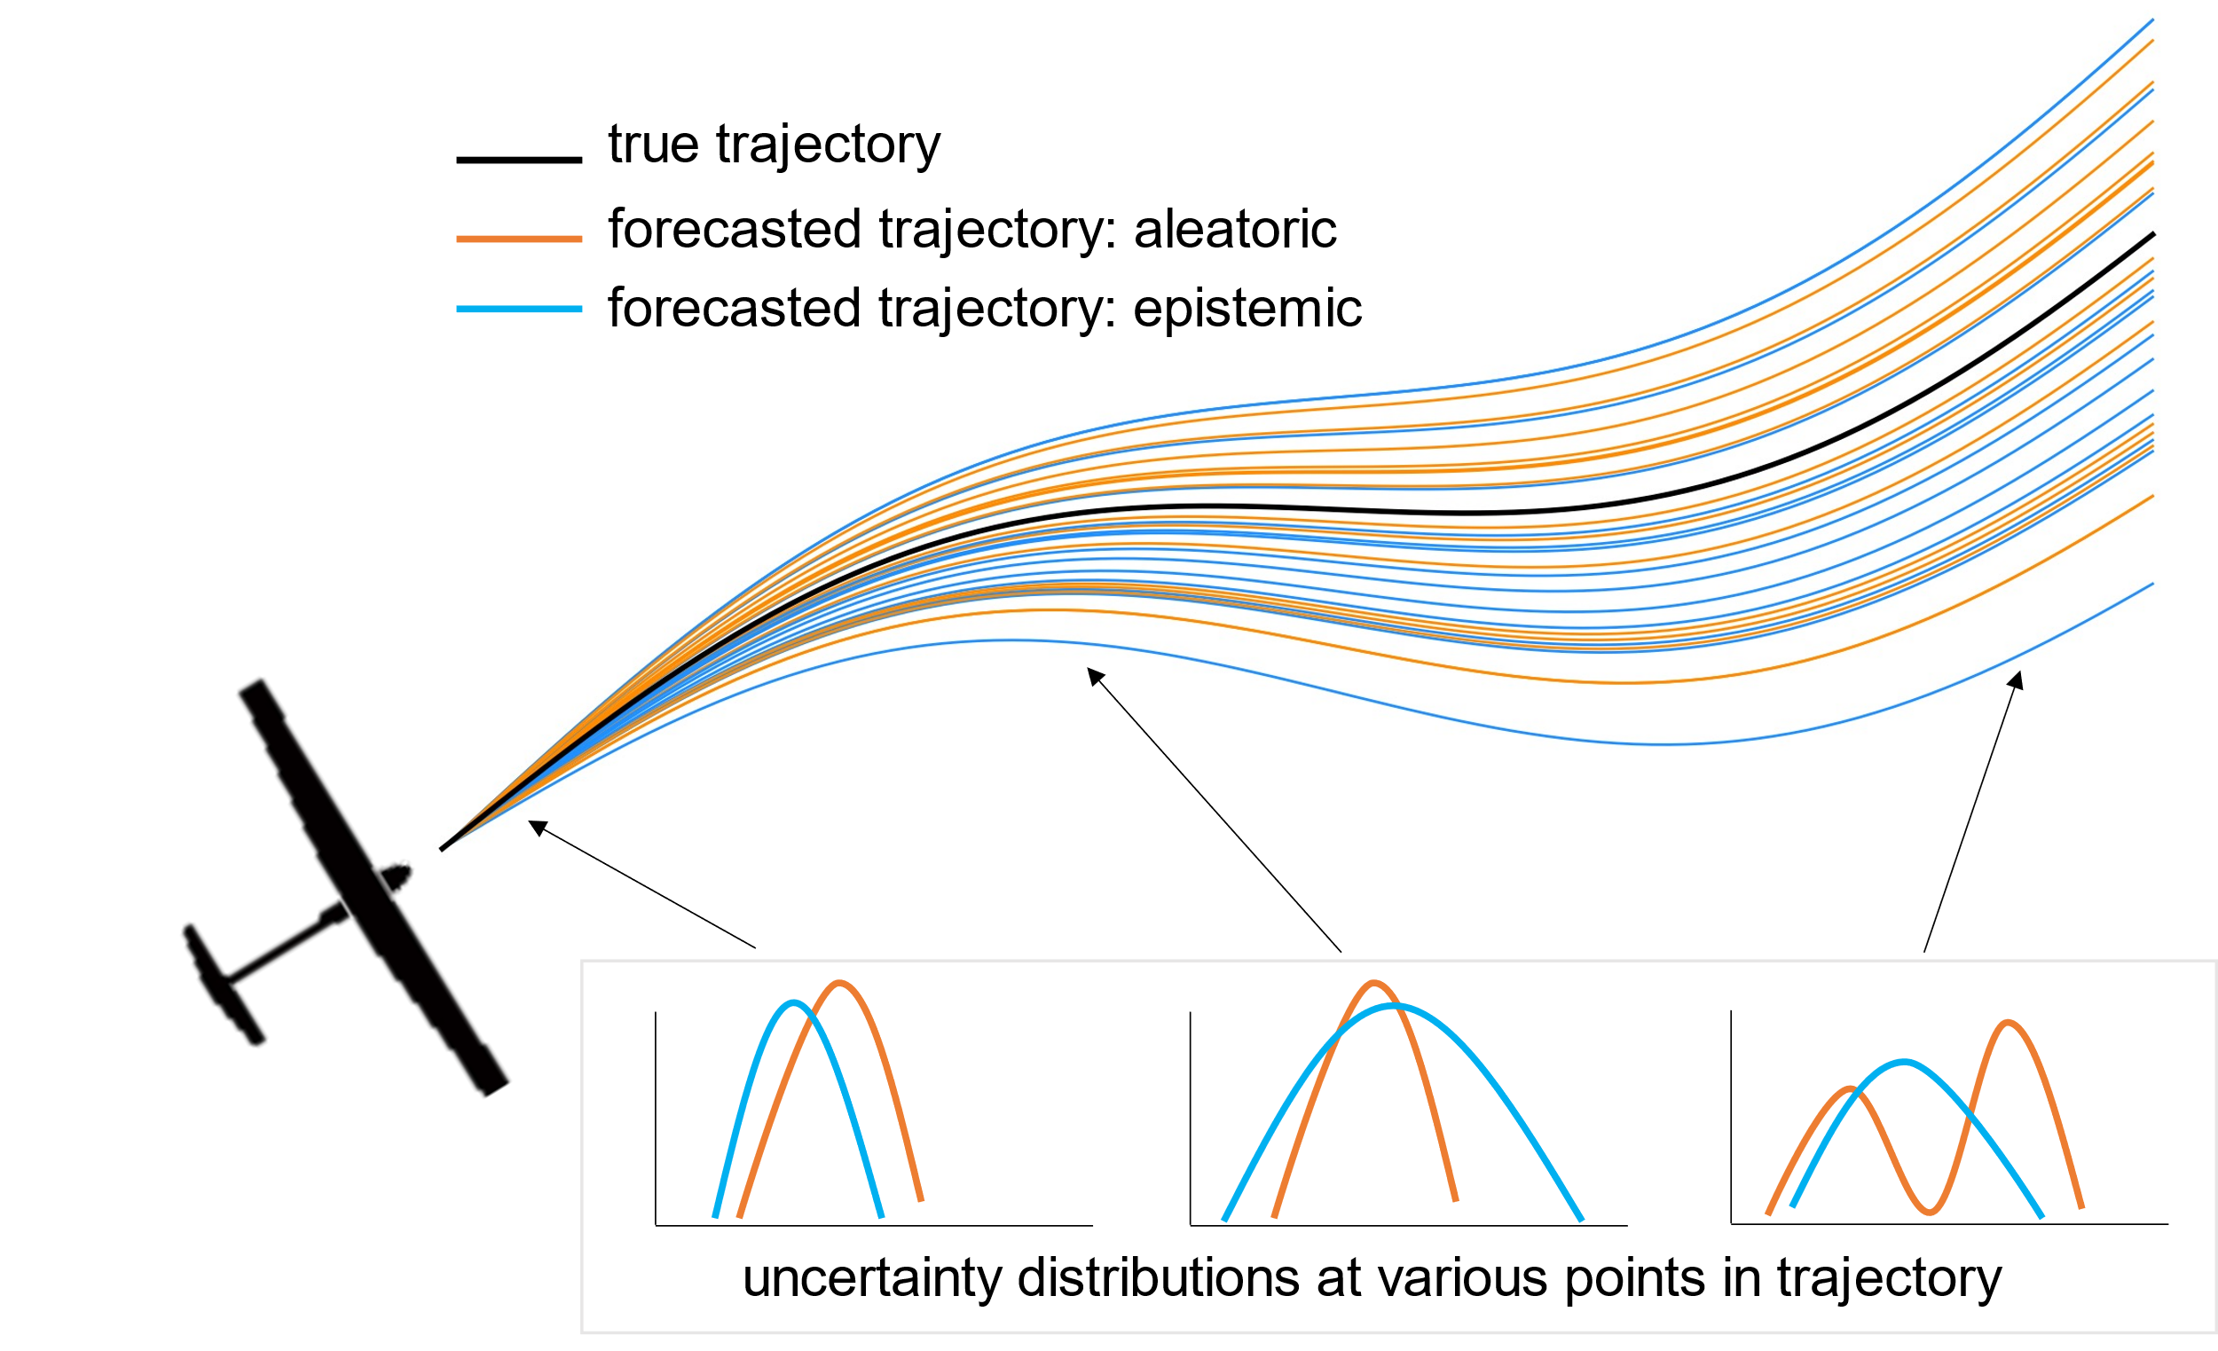
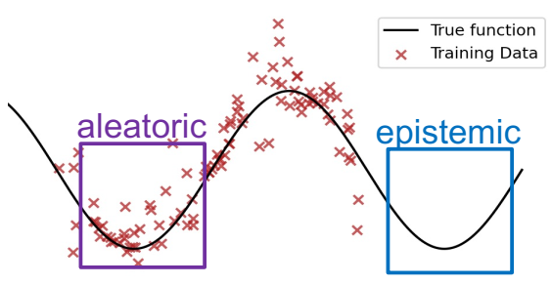
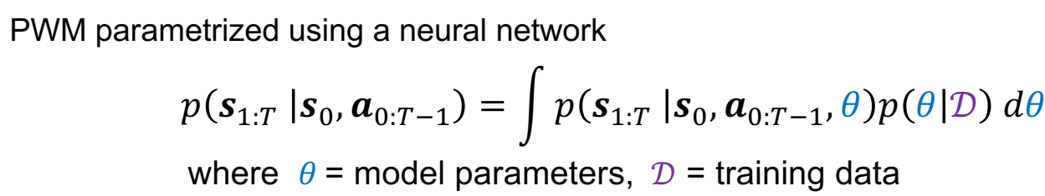
Uncertainty Quantification [Acharya, Russell, Ahmed, ICRA 2023]
Useful forecasting + competency assessment requires identifying:
Aleatoric uncertainties : inherent randomness (process/sensor noise)
Epistemic uncertainties: model ignorance (can →0 with more training data)
Want to give users insights about WHY, WHERE, WHEN robot is/isn’t confident enough to accomplish tasks
(i.e. “don’t know enough” vs. “nature won’t let me”)

Slide 14
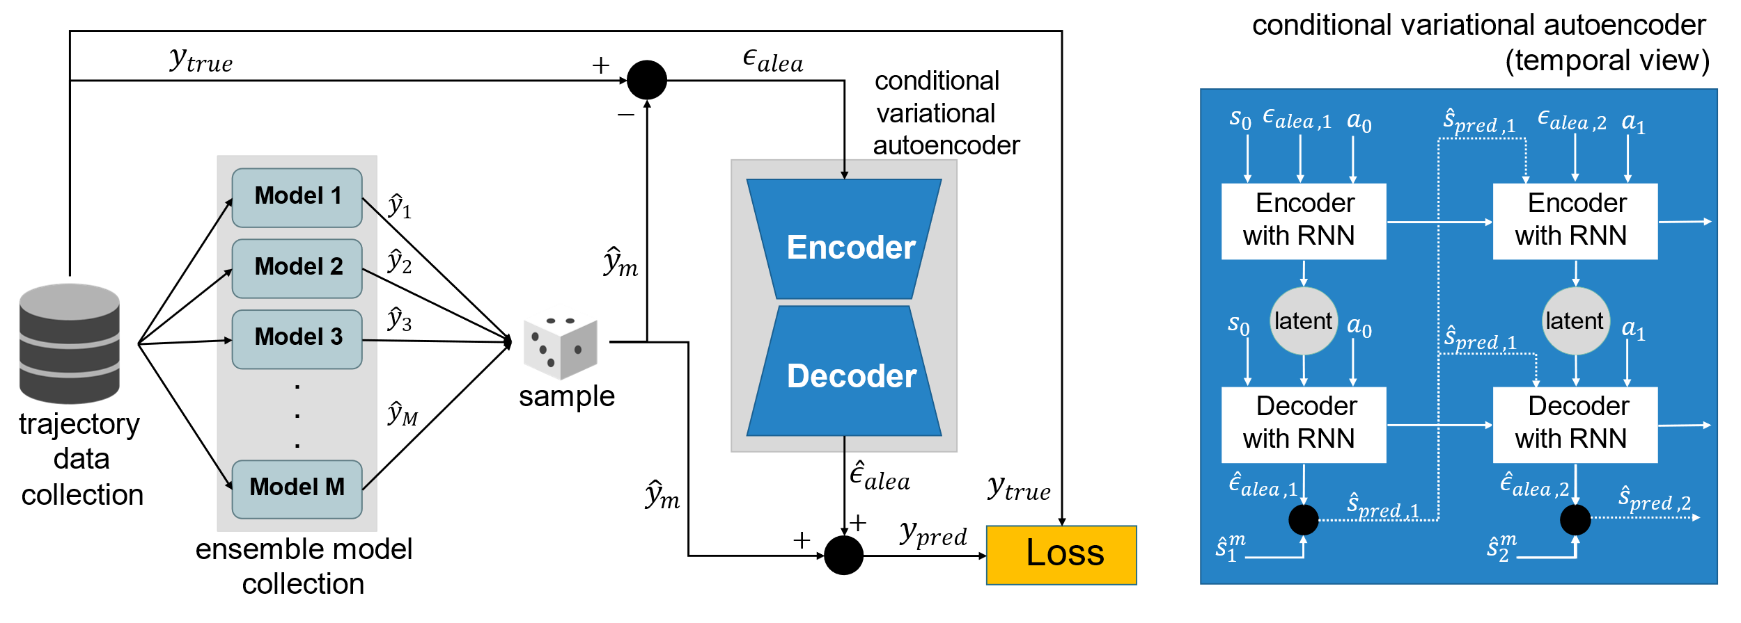
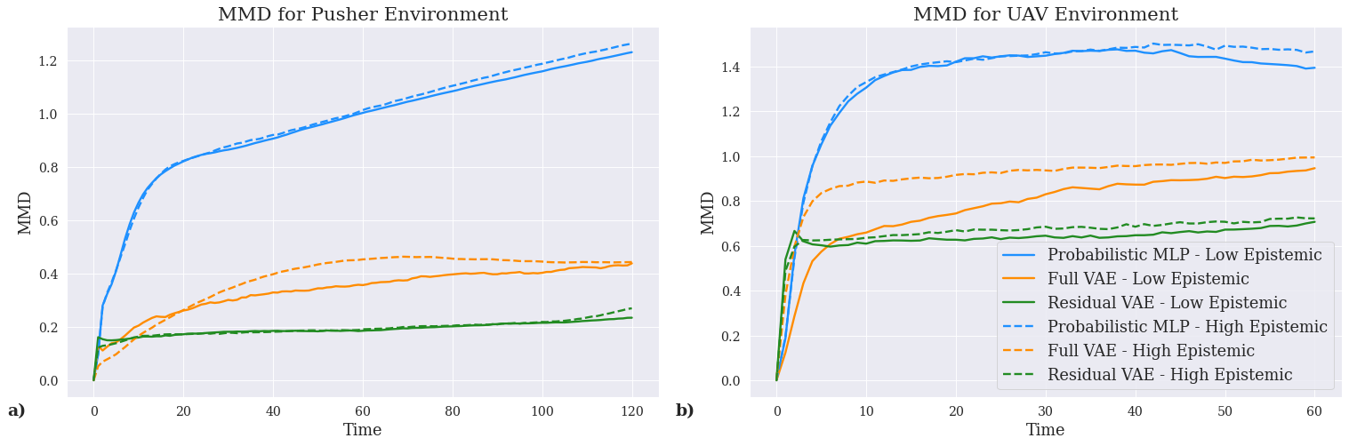
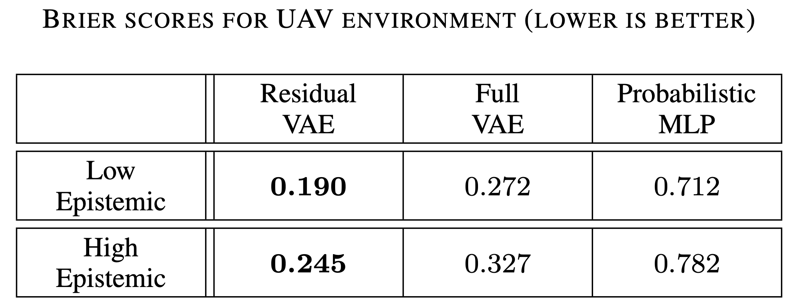
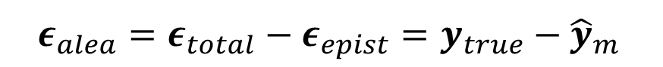
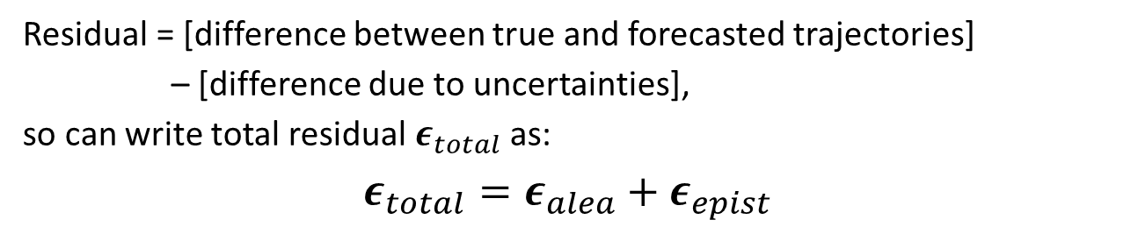
Uncertainty Quantification [Acharya, Russell, Ahmed, ICRA 2023]
Residual = [difference between true and forecasted trajectories]
– [difference due to uncertainties],
so can write total residual $ε_{total}$ as:
$$ε_{total}=ε_{alea}+ε_{epist}$$
$$ε_{alea}=ε_{total}−ε_{epist}=y_{true}−{\hat{y}}_{m}$$

Slide 15
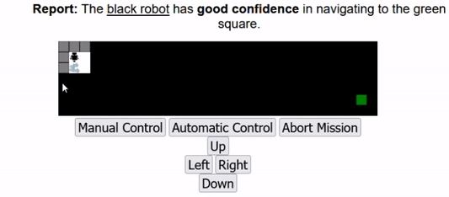
Human Participant Studies (*Non-CAML funded, collab w/ Dan Szafir, UNC) [Conlon, Ahmed, Szafir, IROS 2022]
Does FaMSeC make a difference for actual human users in live tasks?
Amazon Mturk Study (N=74 participants): simulated robot navigation through obstacle-filled disaster area for search/rescue
Users could take over manual control OR delegate to onboard planner
Measures: post hoc trust survey, total task score, #interventions
Key findings:
1. self-confidence reporting leads to better task scores + lower autonomy failure rates
2. trust still tied to actual performance
OA report relative to navigating to the goal
Participant receives limited local information
The participant can toggle control schemes at any time
Notes:
Nick’s work (non-CAML MTurk study w/ Dan Szafir)

Slide 16
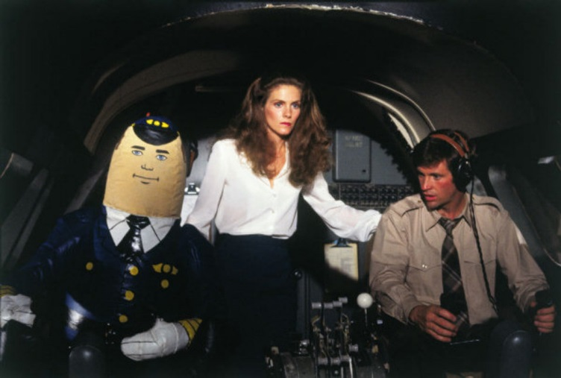
Wrap Up: How to Pass the “Turing Test for Aviation”? (courtesy of Amy Pritchett, Penn State)
Ability to do a task
Ability to report when it can’t do a task
Ability to flex the task structure to achieve desired ends
Ability to adapt its goals to the situation
Ability to communicate/coordinate in way that makes sense to other agent
Ability to ignore other agent when necessary
Ability to recognize and use interdependencies in inter-agent activities
Ability to operate at many levels of abstraction simultaneously
Radar
What would one aviation agent expect from another?
Otto the Automatic Pilot (Airplane!, 1980)
Datalink

Slide 17
Acknowledgments
*Grad students: Aastha Acharya, Nicholas Conon
*CU Collaborators: E. Frew, D. Lawrence, B. Argrow
*Academic and Industry partners:
-Draper (R. Russell, C. Reale, M. D’Alonzo),
-UT Austin (U. Topcu and students),
-Arizona State University (X. Zhu and students),
-UNC (Dan Szafir)
This work was sponsored by:
DARPA Competency Aware Machine Learning (CAML) program
(contract HR001120C0032)
The Smead Faculty Fellowship

